Slide 1
Naive Bayes with Hierarchical MCA
Lakshmi Katrapati, Ipek Sayar

Slide 2
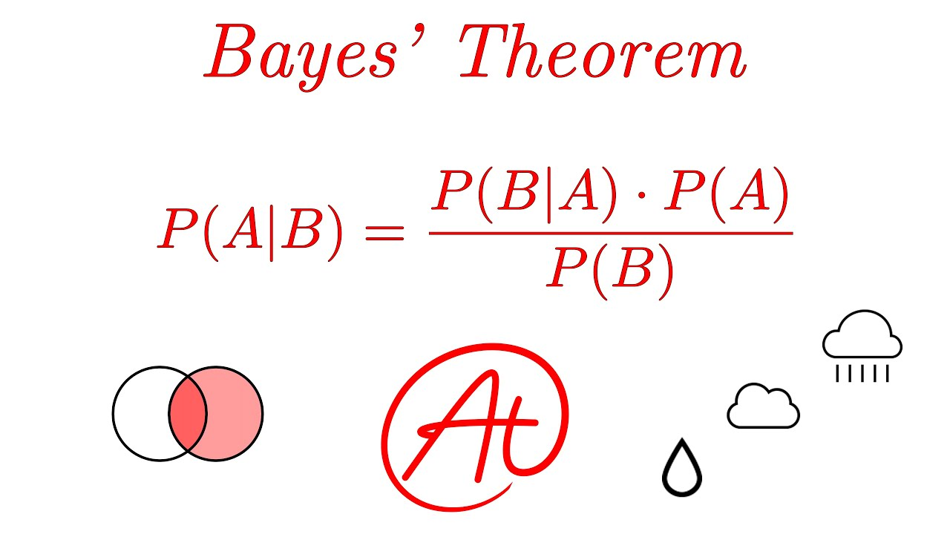
Introduction
Naive Bayes assumes features are independent of each other
Want to improve Naive Bayes by making it work for dataset with correlated features
Goal: Create an algorithm that improves Naive Bayes by accounting for feature dependencies -> allowing it to perform effectively on datasets with correlated features

Slide 3
Related Works
Integrating advanced principal component analysis into naive bayes for enhanced classification performance by Lan Luo, Tianyang Liu
PCA transforms the data into principal components, reducing the relationship between correlated variables
This reduction helps meet Naive Bayes' independence assumption, improving classification performance

Slide 4
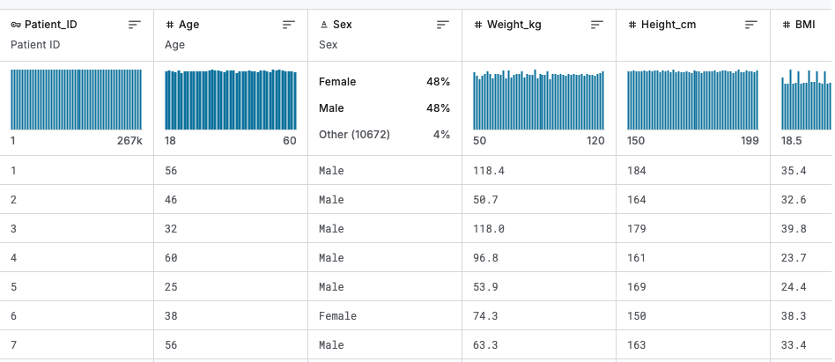
Dataset
Heart Attack for Individuals in France
Class Label = Heart Attack
26 Features
Age
Height
BMI
Blood Pressure Levels
266,785 Instances
Each Instance is a patient

Slide 5
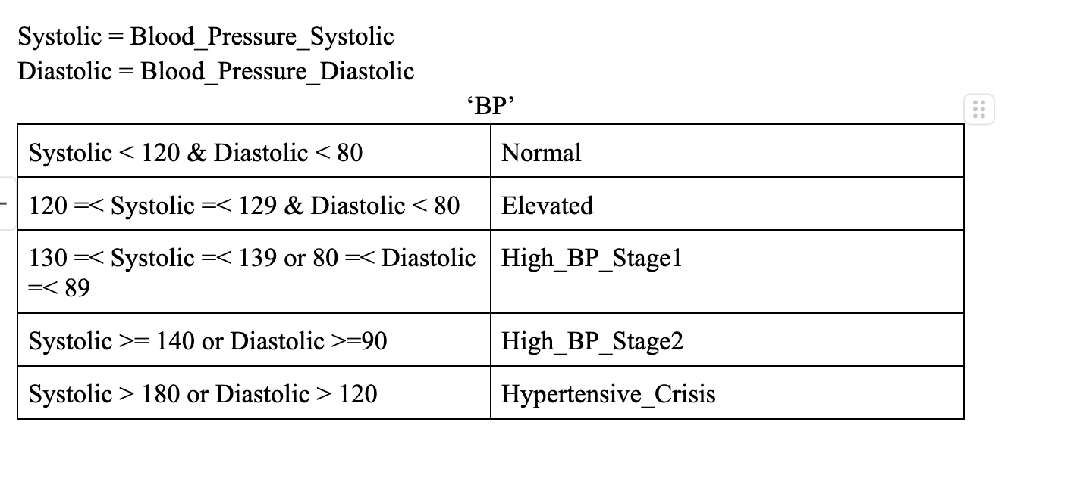
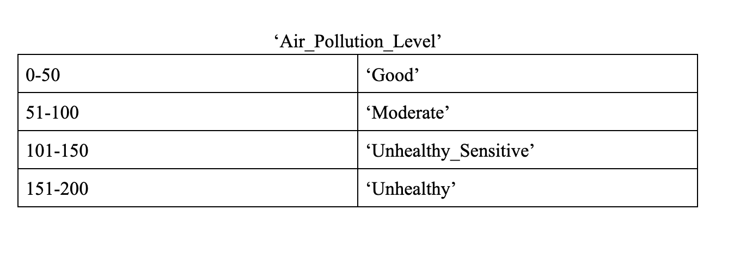
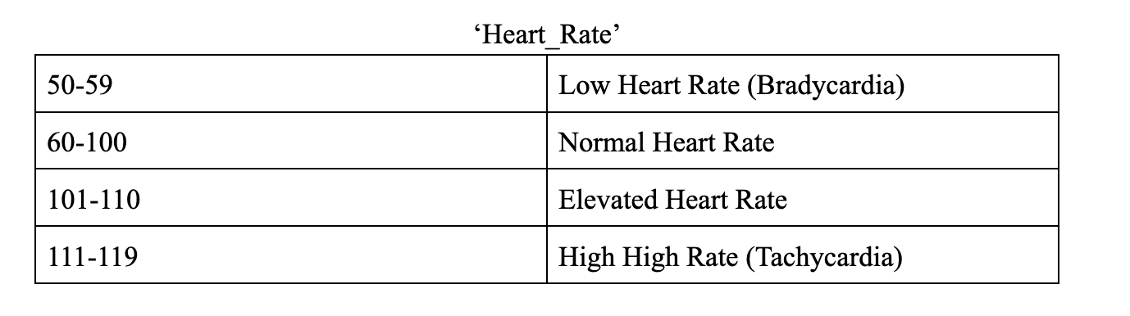
Preprocessing
Notes:
Features that contain numerical values were discretized into categories. Categories were based on known values found online. Some features were combined into one (ie. BP Systolic and BP Diastolic) Some were deleted because served no purpose (such as Patient Id)

Slide 6
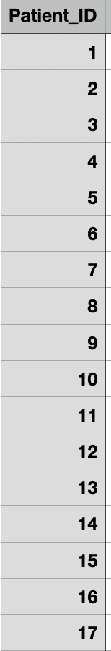
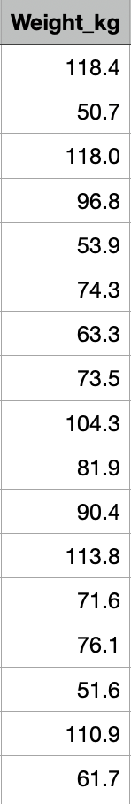
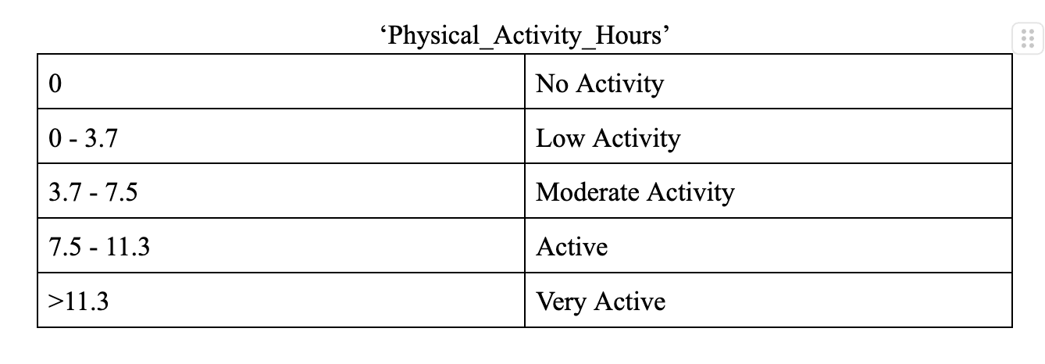
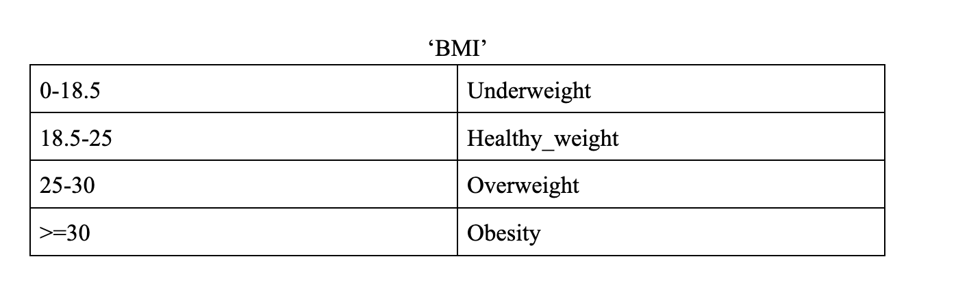
Preprocessing - Cont.
X
Notes:
Patient_ID was discarded because it gives no new information while weight_kg was discarded because weight was included in the calculation for BMI so it also gave new information. More examples of attributes that were discretized.

Slide 7
Algorithm
We will improve the Naive Bayes algorithm by addressing its weakness, the assumption of attribute independence, using Multiple Component Analysis.
What is MCA?
MCA is a dimensionality reduction technique specifically designed for categorical variables, similar to how PCA (Principal Component Analysis) works for continuous data.
Transforms the data into new variables, or "dimensions," that capture the patterns and relationships between the categories of the attributes.
The output is completely independent.

Slide 8
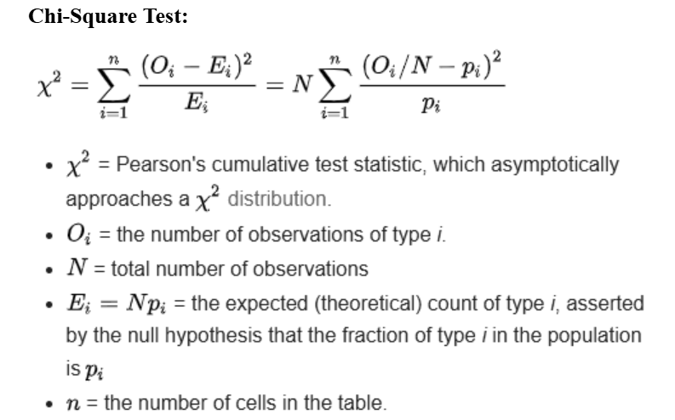
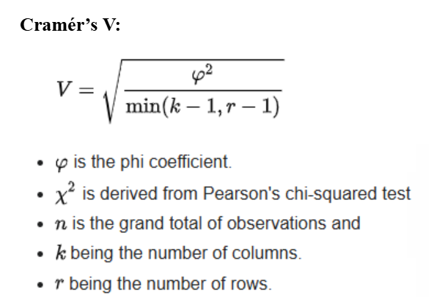
Chi-Square Test checks if the variables are related, Cramér’s V tells you how strong that relationship is.

Slide 9
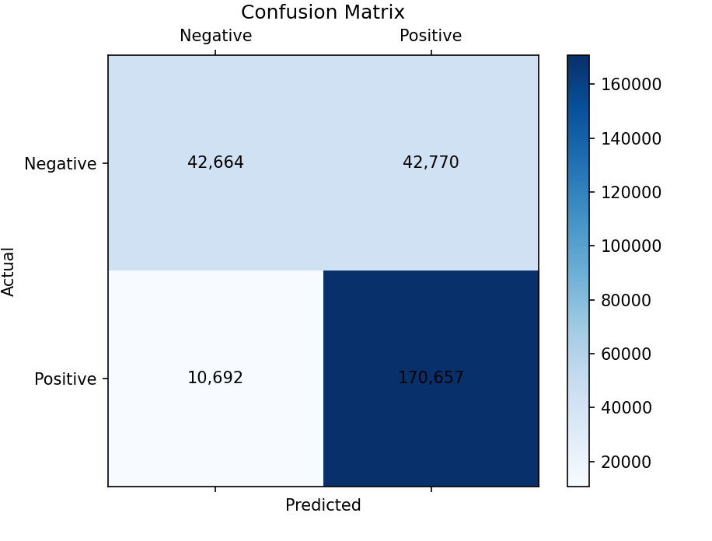
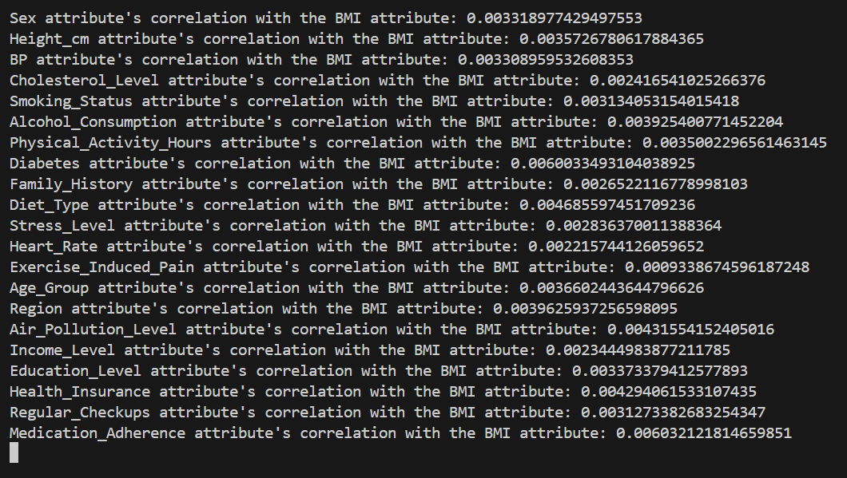
Complement Naive Bayes
Designed to do better on imbalance datasets (8-2 split)
Focuses on the complement of the minority class
focuses on how features contrast with the minority class, rather than just memorizing patterns
Strengthens the model’s ability to recognize what doesn’t belong to the other classes, indirectly improving minority class detection
Pretty good accuracy on this dataset; attributes are already pretty independent from each other
Accuracy: 79.96% Recall: 0.9410
Cramer's V values ^^ Normally 0.005 independence threshold

Slide 10
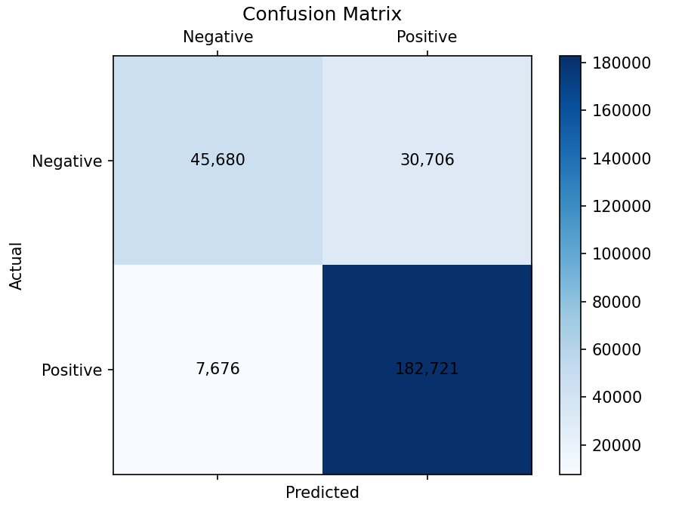
Naive Bayes with Full MCA
Accuracy: 85.61% Recall: 0.9597
Full MCA is applied to the dataset, which produces a set of components that combine related attributes while maintaining their meaning.
Ensures the data better aligns with Naive Bayes' assumptions of feature independence.
Combining all attributes at once may dilute meaningful patterns, making classification less effective

Slide 11
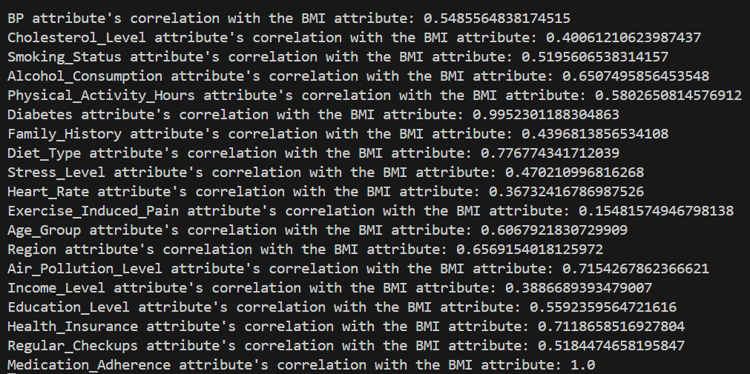
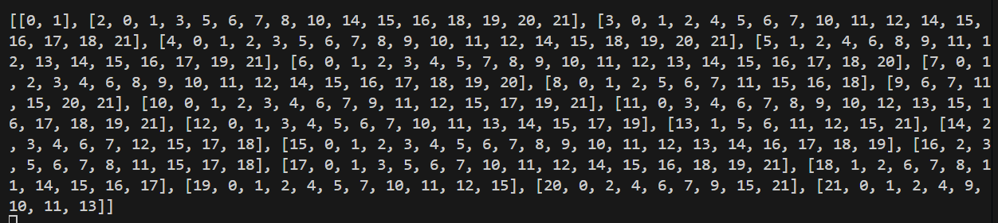
Naive Bayes with Hierarchical MCA
Assume dependencies exist between attributes.
Normalize Cramér’s V values between 0 and 1.
Threshold of 0.5:
Values above 0.5 = moderate dependence
Values below 0.5 = considered independent
Apply MCA (Local Level)
Generate combinations of dependent attributes
Apply MCA Again (Global Level)
Ensures that overlapping attributes don’t reintroduce dependencies
Create a global combination of the dataset.
Breaks down complex dependencies in stages
Ensures complete independence in the final dataset

Slide 12
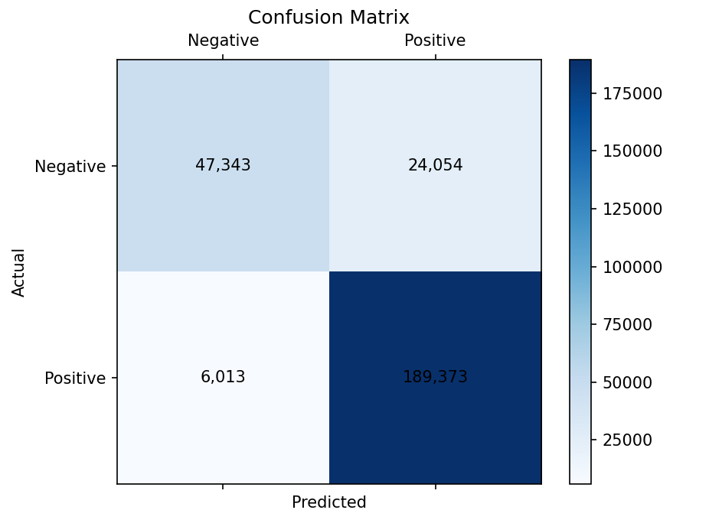
Naive Bayes with Hierarchical MCA
Concerns
Second round of MCA might introduce noise.
Subtle relationships between attributes could be lost during the process.
Potential for missed patterns leading to reduced performance
Accuracy: 88.73% Recall: 0.9692

Slide 13
Future Improvements
Performance improvements were observed, but they may be limited to the current dataset.
The dataset used already had many independent attributes.
Should test on datasets with more dependent attributes
Hierarchical MCA may offer greater improvements in handling complex, dependent relationships

Slide 14
References
https://www.ewadirect.com/journal/aorpm/article/view/18055

Slide 15
Thank You

